Slide 1
College Football Data Analysis & Engineering
Grant Kerkman

Slide 2
AGENDA
Project Overview
Web Scraping
ETL
Analysis
Job Search
Current Position

Slide 3
Project Overview
Side project developed during Bootcamp
Increase employment opportunities
Heavy focus on data engineering with an emphasis on developing robust scripts for ad-hoc analysis
Medium blog part of multi-pronged effort to broaden scope of employment opportunities

Slide 4
Web Scraping

Slide 5
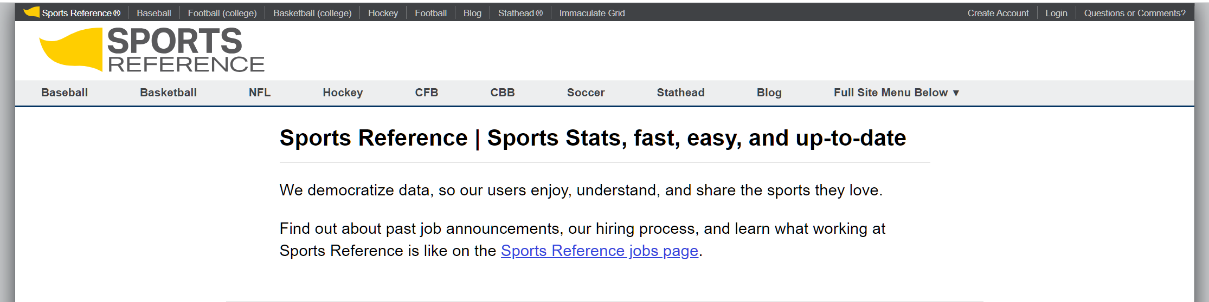
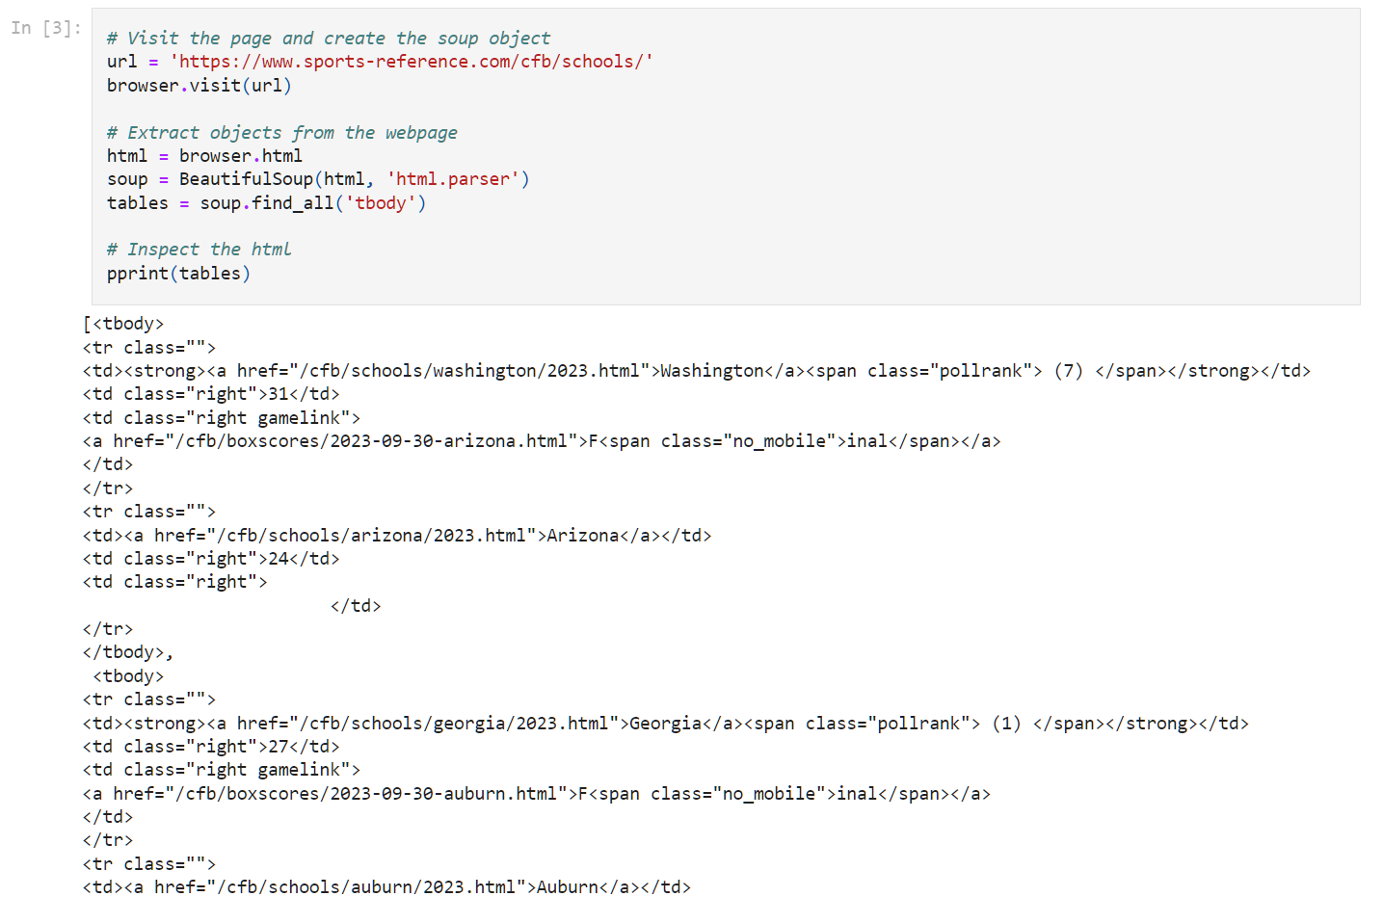
Web Scraping
Languages: Python, HTML
Tools: Splinter, BeautifulSoup, Pandas
Blog: Web Scraping for Insights in College Football
Three scripts pull from different tables
School List generates a list and URL link for all teams that played from 2000 – 2022
School Stats scrapes detailed statistics for an individual team
School Year Statistics scrapes aggregate detailed data and a separate table for standings for all teams
All scripts output .csv files to Resources directory for further data processing

Slide 6
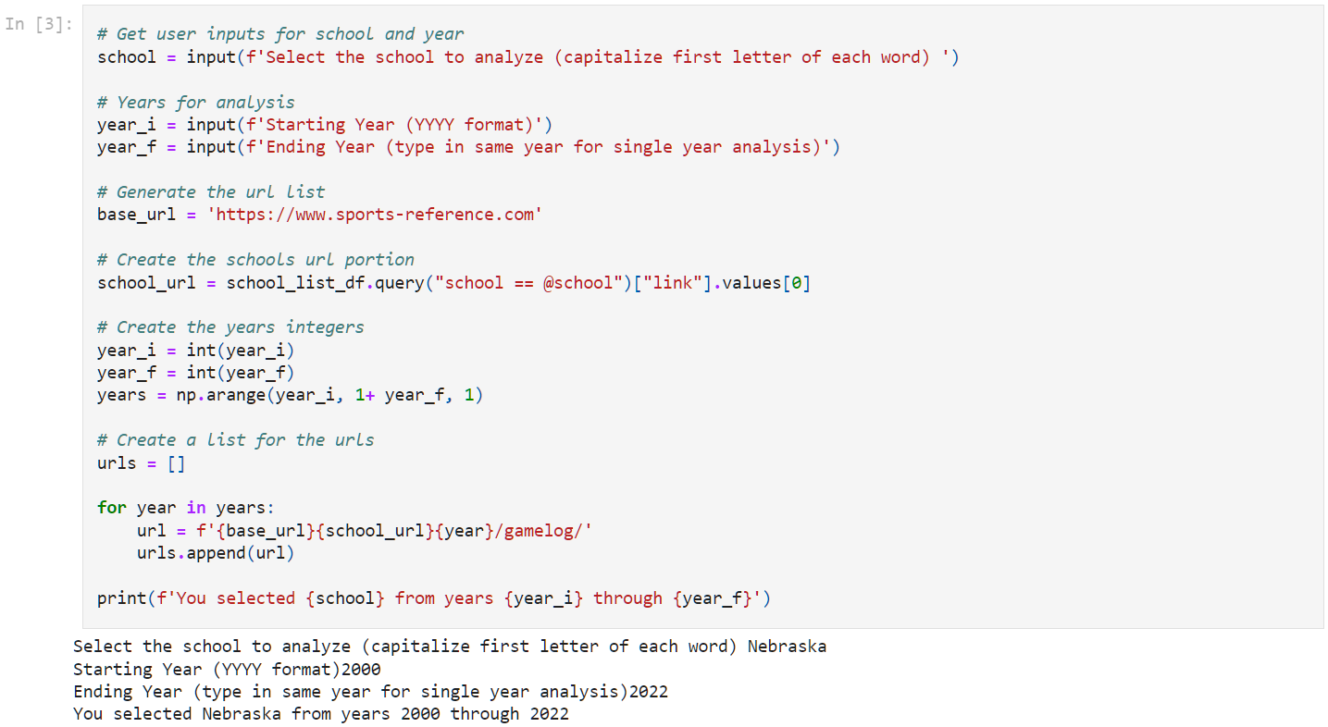
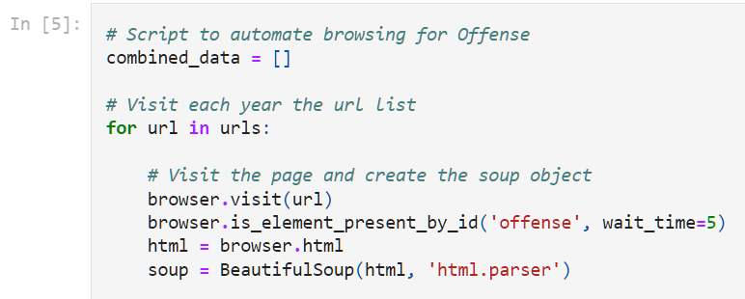
User Scripting – Web Scraping
The School Stats Script generates detailed statistics for user-defined teams and date ranges
Allows for ad-hoc analysis of individual teams and how they compare to the league
School names are validated using the School List scraped data

Slide 7
ETL and Data Engineering

Slide 8

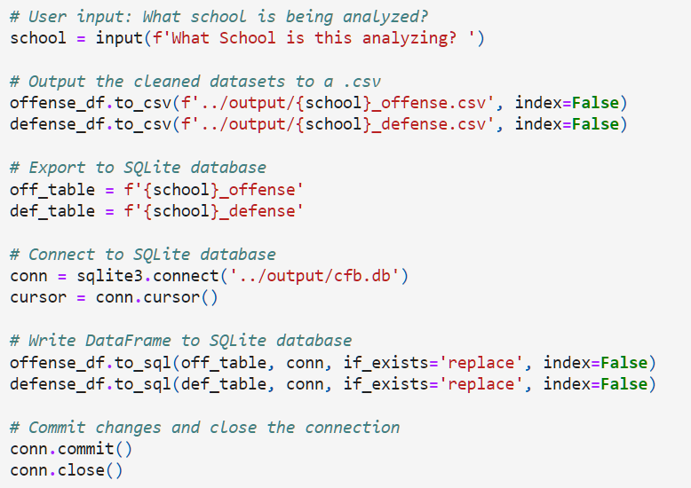
Extract – Transform – Load (ETL)
Languages: Python, SQL
Tools: Pandas, NumPy, SQLite
Blog: Extract! Transform! Load!
Reads in .csv files from web scraping and performs data cleaning and processing
Strategies include filling null values, replacing characters with meaningful values, dropping columns, changing dtypes, and splitting columns apart to tease out more data
Cleaned data is loaded to the SQLite database and output as a .csv in the Output directory
Provides flexibility to the user’s ability and technology constraints

Slide 9
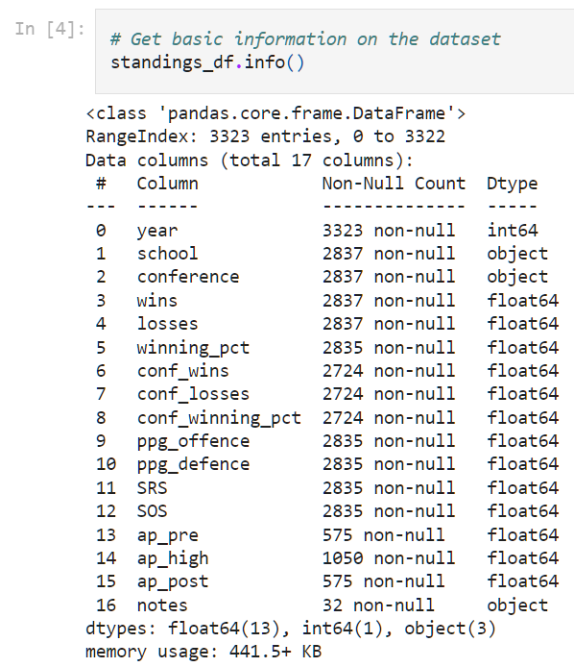
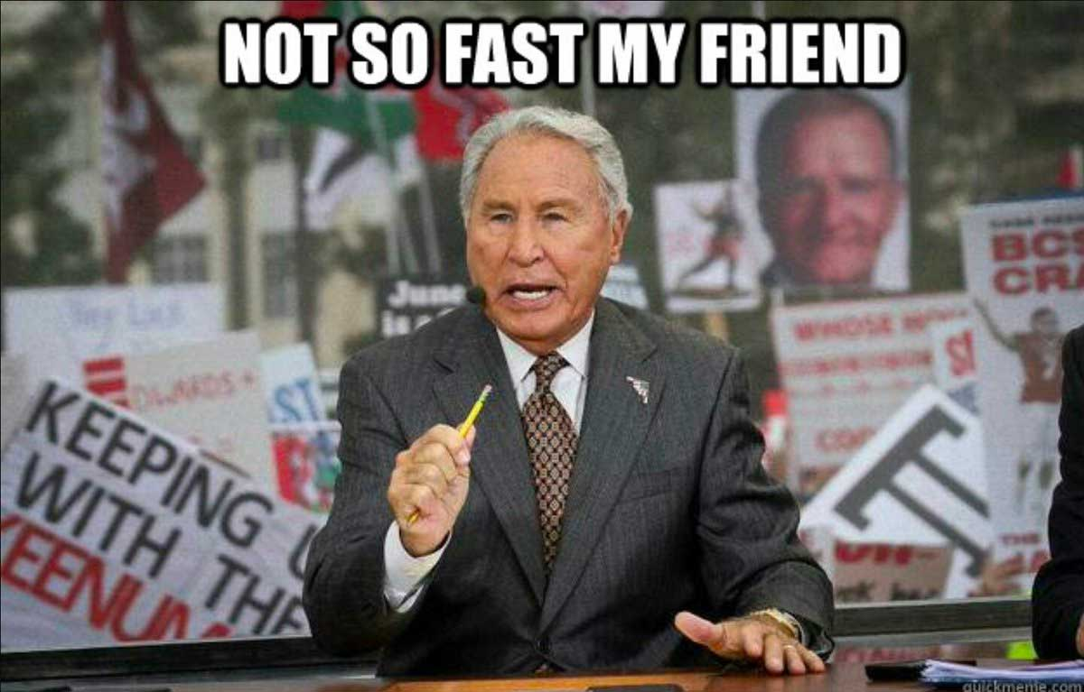
Not so Fast my Friends!
Dedicated blog post Understanding Your Data
Case for why subject matter expertise is invaluable
Dropping columns based on different criteria eliminates useful data
It is important to highlight your understanding of the data in addition to the technical skill of data engineering
This specific blog post was referenced during my interviews and was sent to multiple people in the hiring process

Slide 10
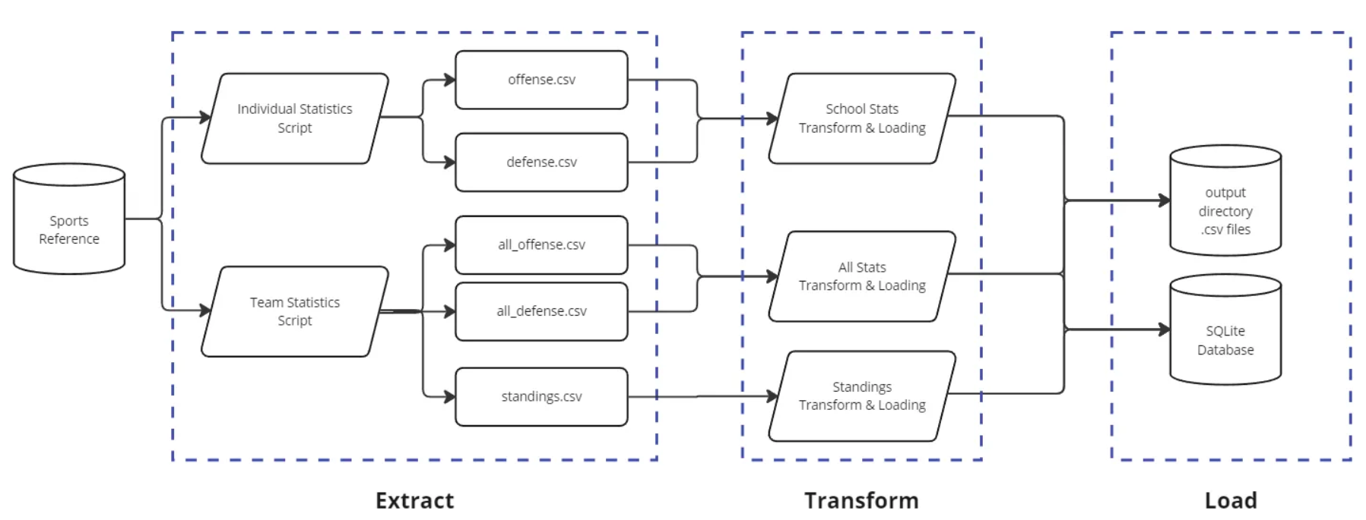
The Data Pipeline

Slide 11
SQL Analysis

Slide 12
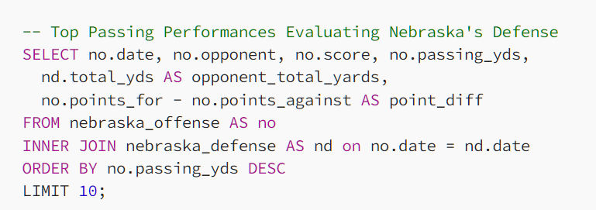
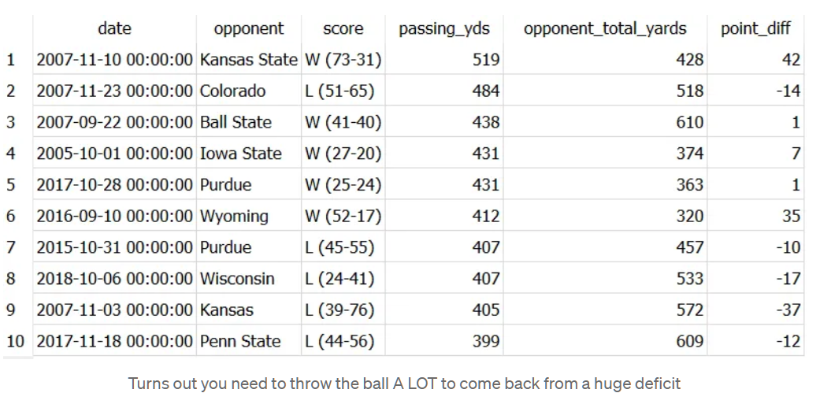
SQL Data Analysis
Languages: SQL
Tools: SQLite
Blog: Asking Questions and Getting More Questions
Series of SQL queries
Highlighted aggregate functions, joins, and grouping operations
Used as an initial analysis to spur further questions for the detailed analysis

Slide 13
Unsupervised Learning Analysis

Slide 14
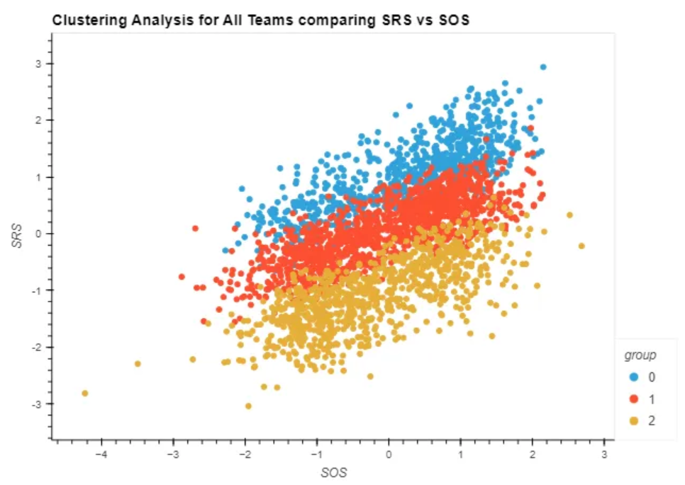
K-Means Clustering
Languages: Python
Tools: NumPy, Pandas, Regex, hvplot, Seaborn, scikit-learn
Blog: Sisyphus in Red
Detailed analysis of the Nebraska Cornhuskers
Required preprocessing to encode data
Notebook creates clusters and codes the ability to analyze a specific team
Generated graphs for all variables relationships and determined Ranking vs Strength of Schedule (SRS vs SOS) as key analytic
Notebook includes PCA analysis although the dataset does not match that analysis type

Slide 15
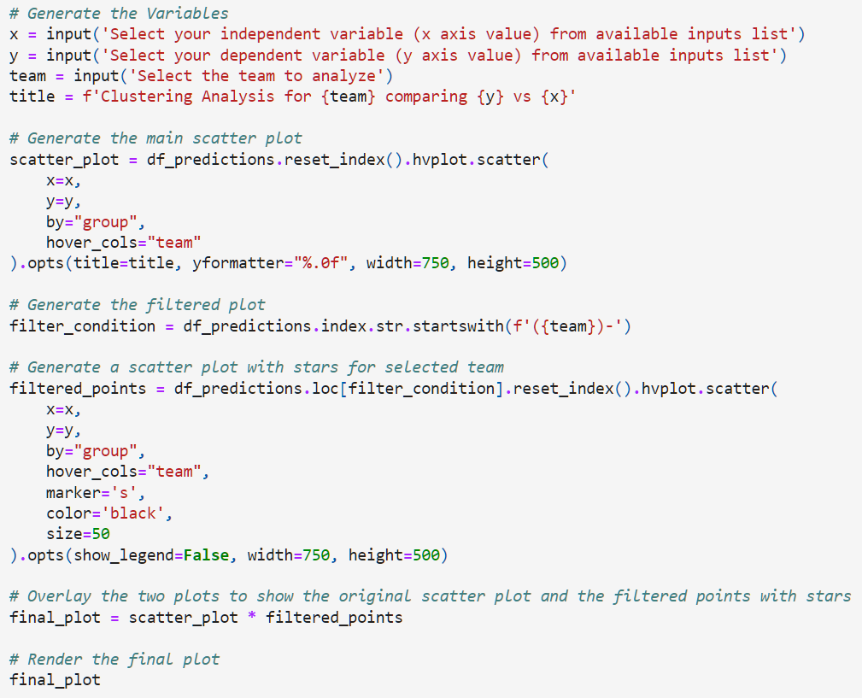
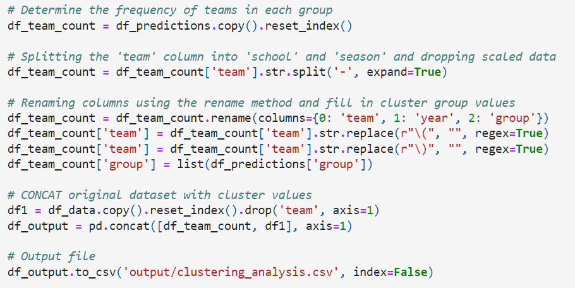
User Scripting – Clustering Notebook
Notebook allows user to select different variables to plot and highlight a specific team
Outputs .png file and .csv for more detailed visualization and data analysis
Taken together all user scripts can provide a starting point for anyone to perform analysis

Slide 16
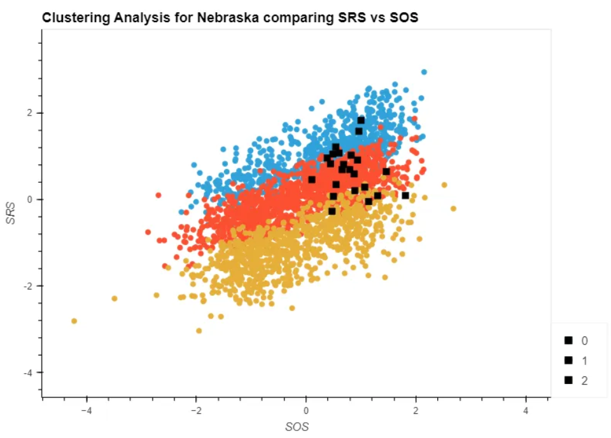



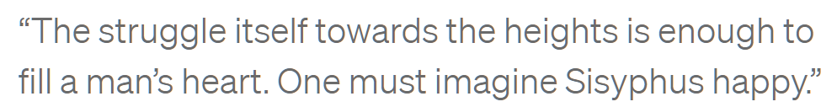

Nebraska Football (tl;dr)
Nebraska Football in under 10 seconds:
We were once very good
We are no longer very good
We begin to get better, we sabotage
Current feelings on the team:
Visit my blog post Sisyphus in Red to read much more about it!

Slide 17
Job Search

Slide 18
My Approach
Previous Experience
GitHub and Coding Project
Social Media: LinkedIn & Medium
10+ years experience in oil & gas as an engineer, PM, and operations manager
Mechanical Engineering background in process engineering and automation
Highlight deep background knowledge
Coding used to fill in technical gaps in my experience
Organized GitHub with pinned folders showcasing projects
Documentation is very important
Professional look and feel
Used to bypass tech interview
Showcase for technical jobs (engineer, developer, analyst)
Medium started to showcase ‘soft’ skills and to increase employment opportunities
Showcase for less technical jobs (PM, Product, sales)
Promoted posts on LinkedIn
Shows that you are a human!

Slide 19
Current Position

Slide 20

Clearway Energy Group Data Analytics Engineer
Interviewed in mid-October (four interviews over three days) and started 11/13
Bypassed technical interview with this project
Medium posts were sent to multiple people in leadership for cultural fit and assessment
Connecting remote assets (wind turbines and solar panels) to database and ensuring proper data flow
Analysis of fleet performance and optimization
Using Python, SQL, and Power BI

Slide 21
Thanks Bill!
Grant Kerkman
linkedin.com/in/grantkerkman
github.com/grantkerkman
medium.com/@grantkerkman

